Slide 1
Part 1: overview
Principal Component Analysis (PCA)
Partial Least Squares (PLS)
Maximal covariance principle
Two-way Orthogonal PLS (O2PLS)
Group sparse O2PLS
Post-hoc analyses using external databases
Notes:
Theory 5 – 10 min
Data

Slide 2
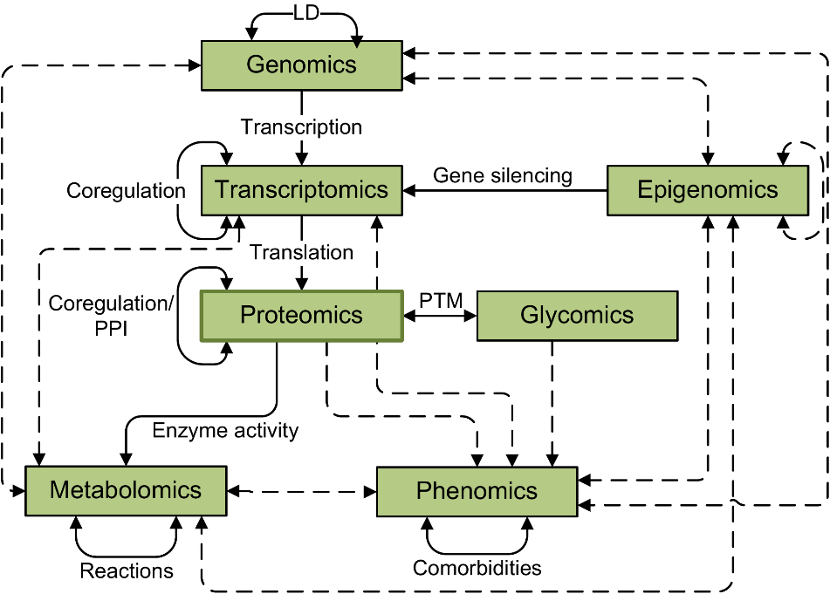
Background
Recent advances in technology provided many types of biological datasets (multi-omics data)
Different levels of biological variation measured
Need for integrative approaches: combine data and extract information

Slide 3
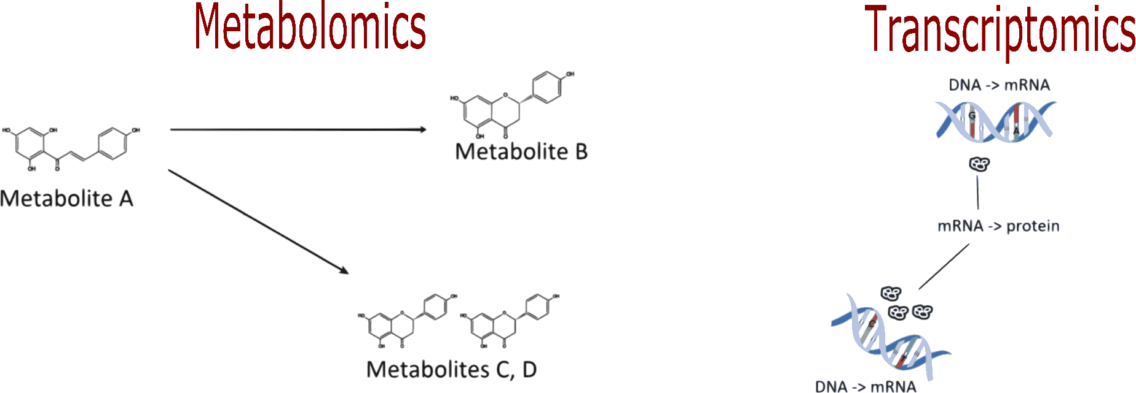
Integrative approach: aims
How does variation between omics datasets relate?
Which types of features induce this variation?
Can we benefit from a joint/integrative analysis?

Slide 4
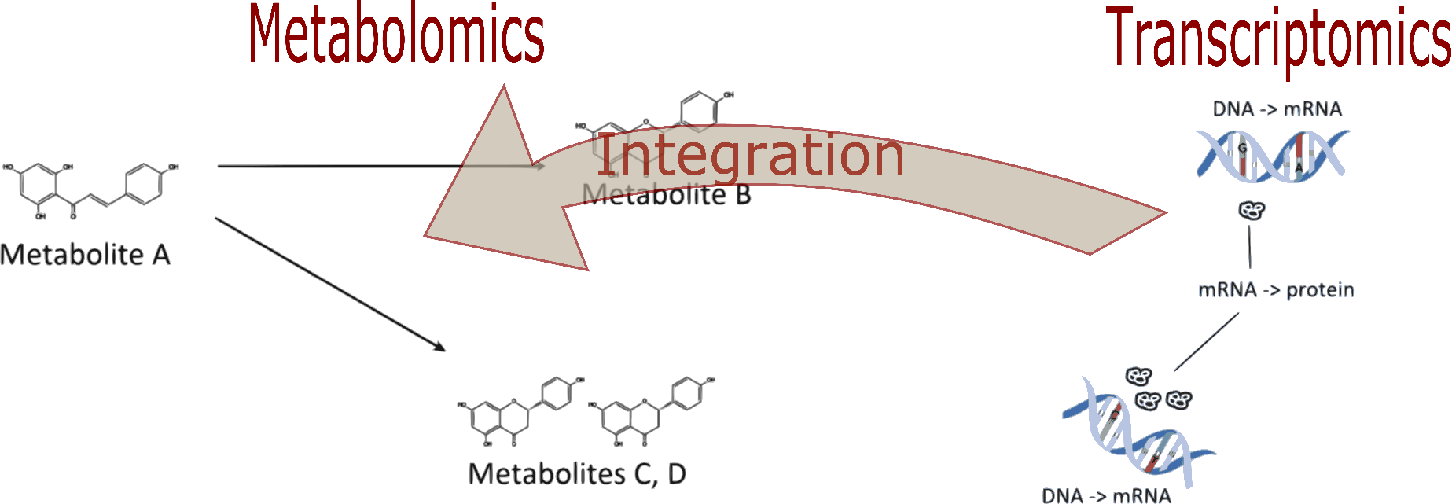
Integrative approach: aims
How does variation between omics datasets relate?
Which types of features induce this variation?
Can we benefit from a joint/integrative analysis?

Slide 5
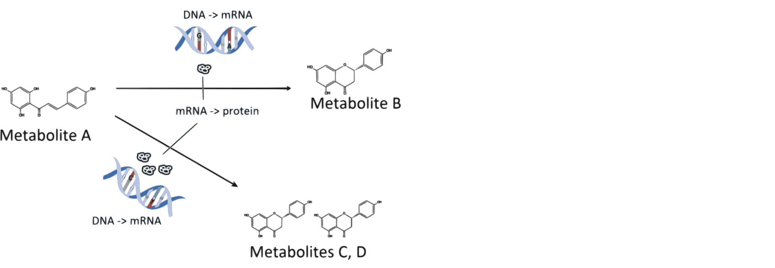
Integrative approach: aims
How does variation between omics datasets relate?
Which types of features induce this variation?
Can we benefit from a joint/integrative analysis?

Slide 6
Integrative approaches: means
There is typically
High correlation among features
Genes are correlated
Metabolites are correlated
Relation between features from two datasets
Dimension reduction approach: few components drive association

Slide 7
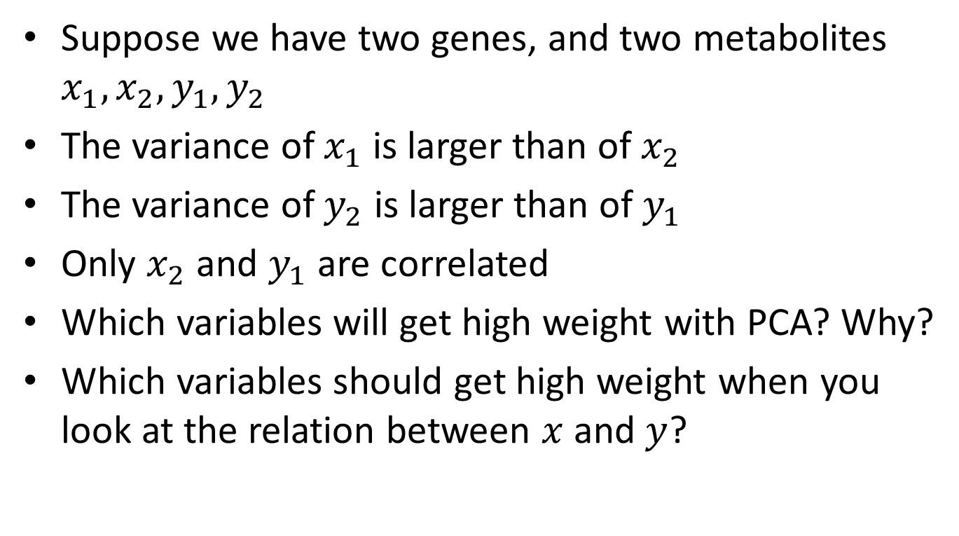
Example: bivariate data
Suppose we have two genes, and two metabolites $x_{1},x_{2}, y_{1},y_{2}$
The variance of $x_{1}$ is larger than of $x_{2}$
The variance of $y_{2}$ is larger than of $y_{1}$
Only $x_{2}$ and $y_{1}$ are correlated
Which variables will get high weight with PCA? Why?
Which variables should get high weight when you look at the relation between $x$ and $y$?

Slide 8
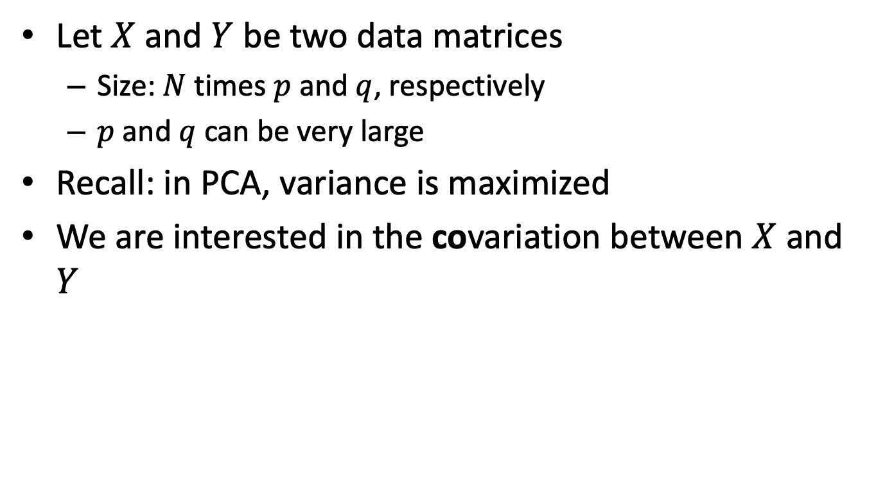
Partial Least Squares (PLS)
Let $X$ and $Y$ be two data matrices
Size: $N$ times $p$ and $q$, respectively
$p$ and $q$ can be very large
Recall: in PCA, variance is maximized
We are interested in the covariation between $X$ and $Y$

Slide 9
Partial Least Squares (PLS)
Objective: maximize covariance between both linear combinations
The combinations are again relative
Can be calculated using
A singular value decomposition (svd in R)
Similar interpretation as PCA, except that we focus on covariance

Slide 10
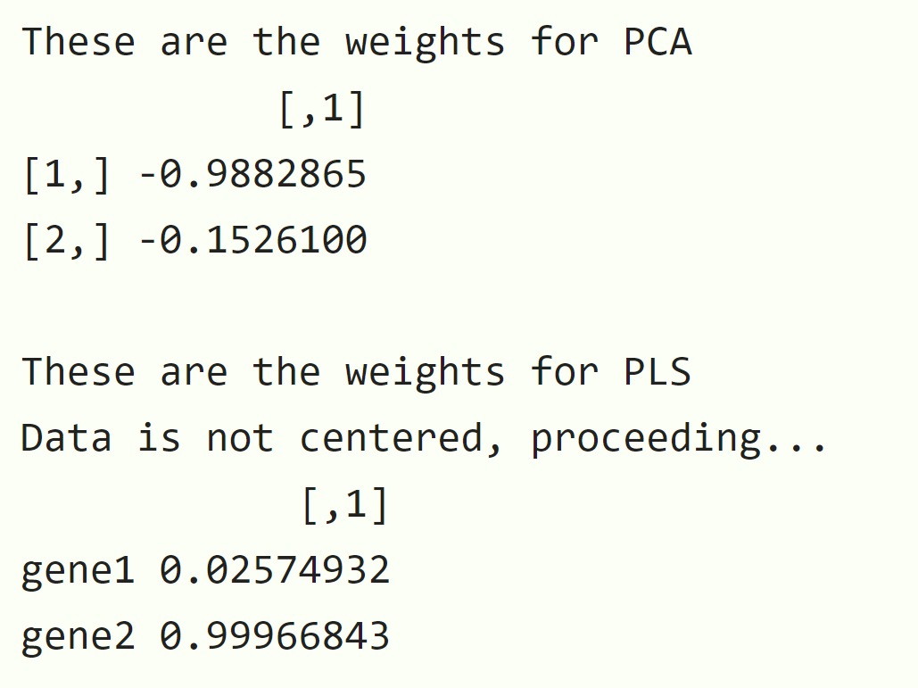
Example: PLS
library(OmicsPLS)
gene1 <- rnorm(100)
gene2 <- rnorm(100,sd=0.75)
metab1 <- rnorm(100)
metab2 <- gene2
X <- cbind(gene1, gene2)
Y <- cbind(metab1, metab2)
svd(X,0,1)$v
o2m(X, Y, 1, 0, 0)$W.
Notes:
Explain difference with PCA

Slide 11
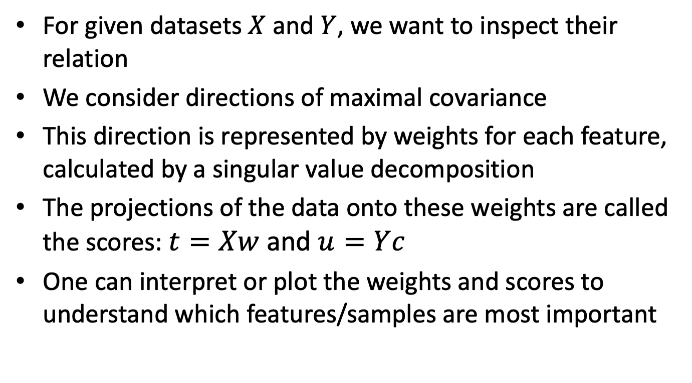
Partial Least Squares: summary
For given datasets $X$ and $Y$, we want to inspect their relation
We consider directions of maximal covariance
This direction is represented by weights for each feature, calculated by a singular value decomposition
The projections of the data onto these weights are called the scores: $t=Xw$ and $u=Yc$
One can interpret or plot the weights and scores to understand which features/samples are most important

Slide 12
Part 1: overview
Principal Component Analysis (PCA)
Partial Least Squares (PLS)
Maximal covariance principle
Two-way Orthogonal PLS (O2PLS)
Group sparse O2PLS
Post-hoc analyses using external databases
Notes:
Theory 5 – 10 min
Data

